Slide 1
How Do Teacher's Questions Equilibrate Our Seat Strategies?
Team Members
柯雪莹
姜昊
徐寅秋

Slide 2
1
Phenomena
NO NO NO!
Don't choose me !
Pick me!
I want to answer question!
Which one should I choose to answer my question?
I have a Question

Slide 3
2
Game Process
DAY 1
α=3/4
β=1/2
p
Who wants to answer this question?
emmm
emmm
. . .
emmm

Slide 4
2
Game Process
DAY 2
. . .
Who wants to answer this question?
α=1/4
β=4/4=1
p'
emmm
emmm
emmm

Slide 5
2
Game Process
DAY 3
. . .
Who wants to answer this question?
α=1/2
β=3/4
p''
emmm
emmm
emmm
after several lectures......

Slide 6
2
Game Process
α=1
β=1/4
p
α=1/4
β=1
p
DAY n
. . .
. . .
Who wants to answer this question?
Who wants to answer this question?
emmm
emmm
emmm
emmm
emmm
emmm

Slide 7
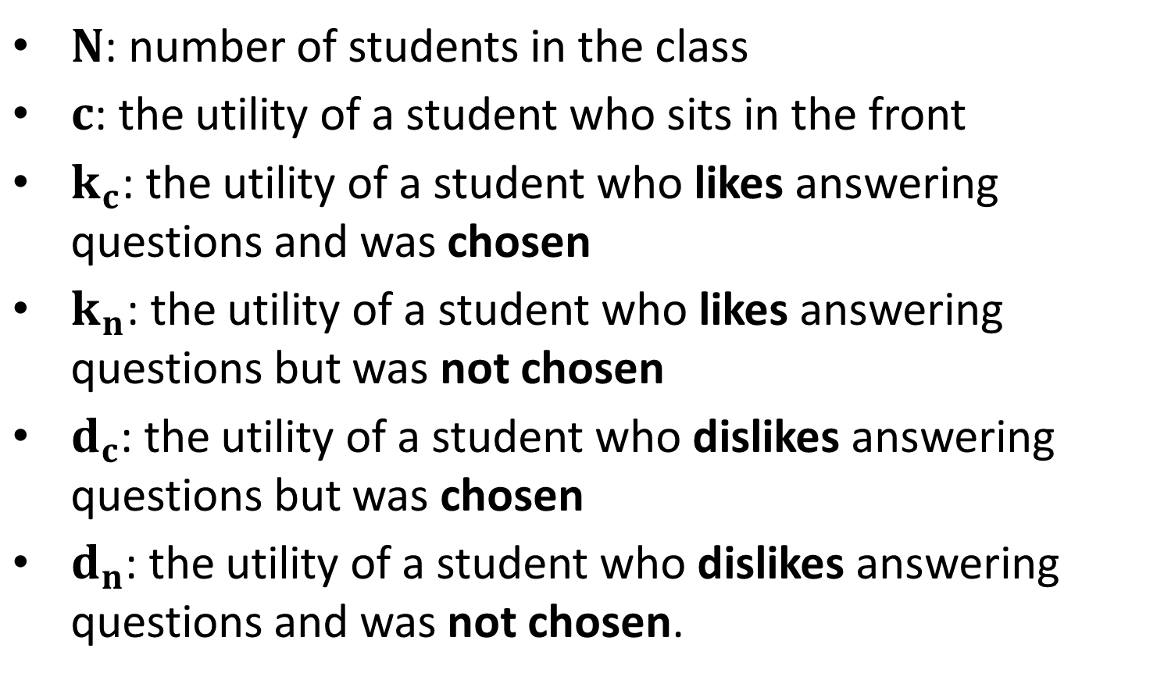
3
Notations
$N$: number of students in the class
$c$: the utility of a student who sits in the front
$k_{c}$: the utility of a student who likes answering questions and was chosen
$k_{n}$: the utility of a student who likes answering questions but was not chosen
$d_{c}$: the utility of a student who dislikes answering questions but was chosen
$d_{n}$: the utility of a student who dislikes answering questions and was not chosen.

Slide 8
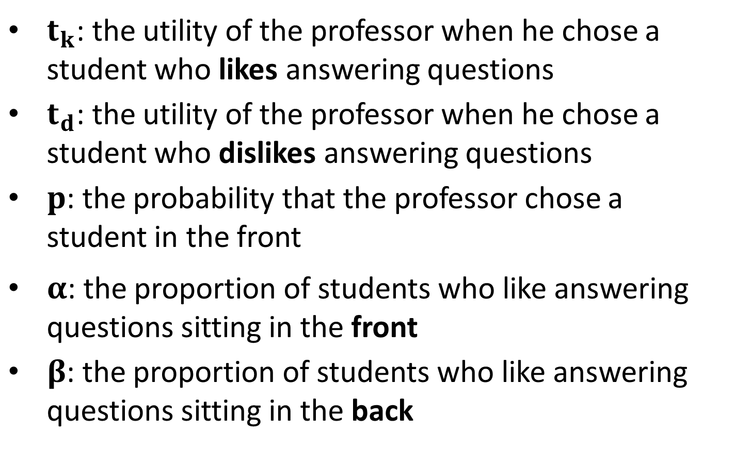
3
Notations
$t_{k}$: the utility of the professor when he chose a student who likes answering questions
$t_{d}$: the utility of the professor when he chose a student who dislikes answering questions
$p$: the probability that the professor chose a student in the front
$α$: the proportion of students who like answering questions sitting in the front
$β$: the proportion of students who like answering questions sitting in the back

Slide 9
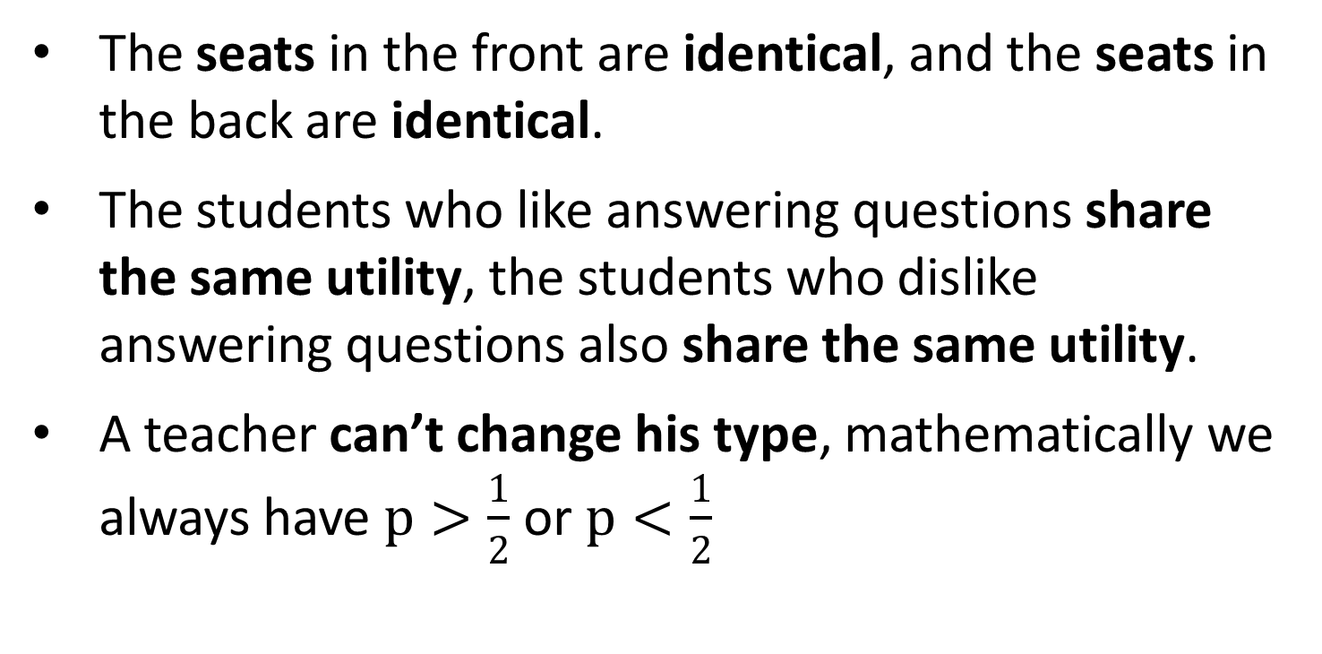
4
Assumptions
The seats in the front are identical, and the seats in the back are identical.
The students who like answering questions share the same utility, the students who dislike answering questions also share the same utility.
A teacher can’t change his type, mathematically we always have $p>\frac{1}{2}$ or $p<\frac{1}{2}$

Slide 10
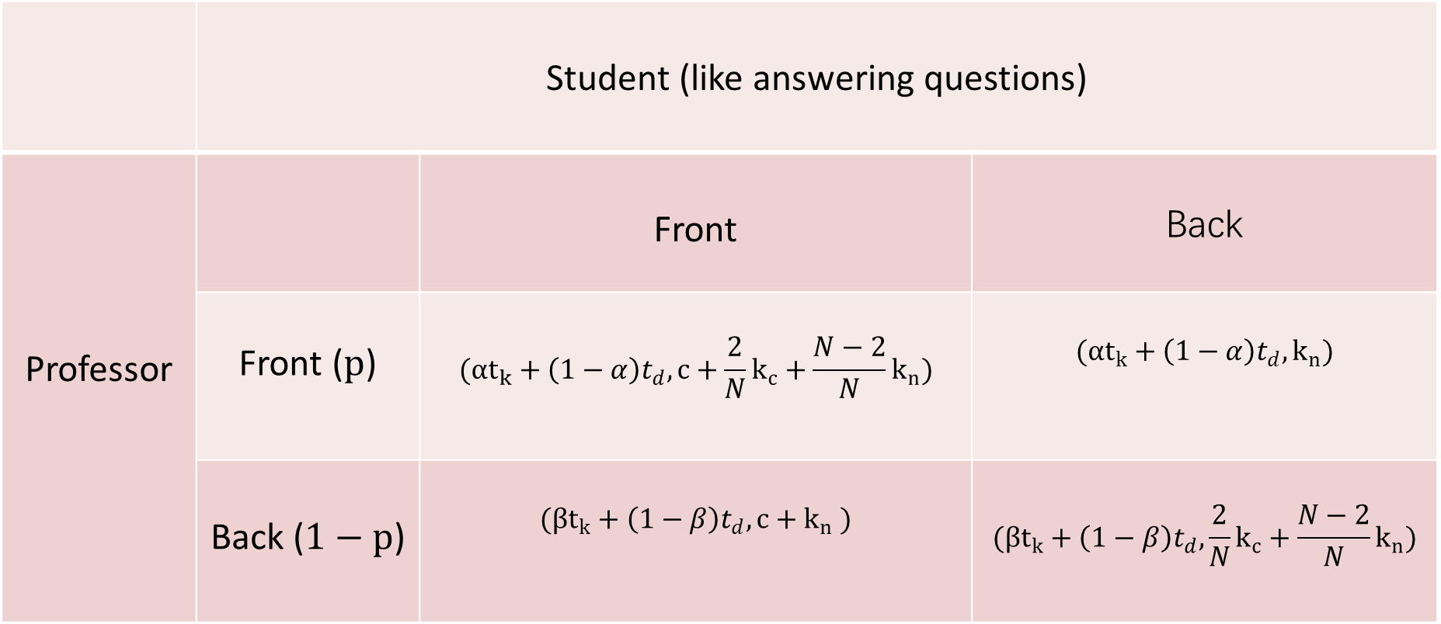
5
Payoff Matrix (like)
 | Student (like answering questions)
Professor |  | Front | Back

Slide 11
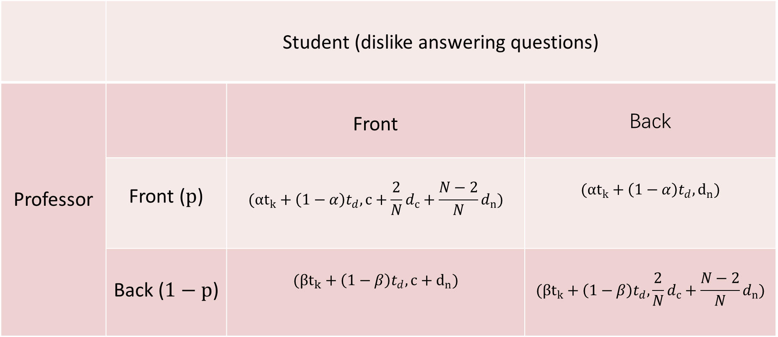
5
Payoff Matrix (dislike)
 | Student (dislike answering questions)
Professor |  | Front | Back

Slide 12
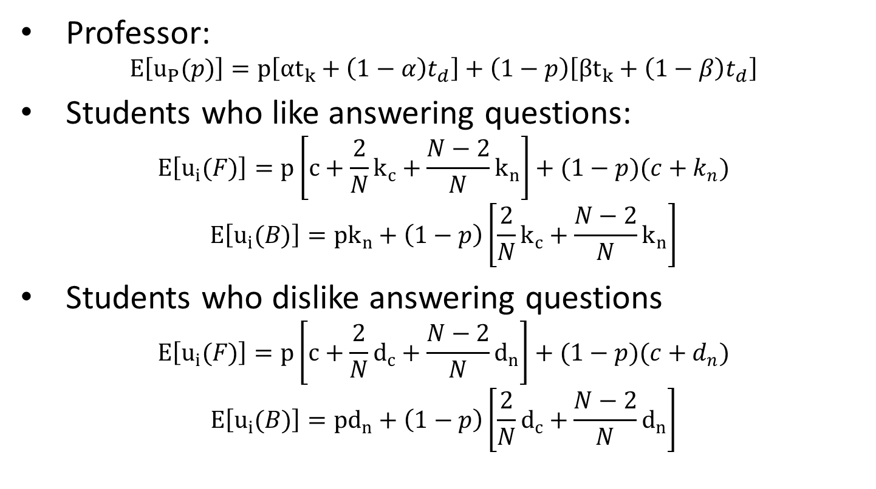
6
Expected Utilities
Professor:
$$E\left[u_{P}(p)\right]=p\left[αt_{k}+\left(1−α\right)t_{d}\right]+\left(1−p\right)\left[βt_{k}+\left(1−β\right)t_{d}\right]$$
Students who like answering questions:
$$E\left[u_{i}(F)\right]=p\left[c+\frac{2}{N}k_{c}+\frac{N−2}{N}k_{n}\right]+(1−p)(c+k_{n})$$
$$E\left[u_{i}(B)\right]={pk}_{n}+\left(1−p\right)\left[\frac{2}{N}k_{c}+\frac{N−2}{N}k_{n}\right]$$
Students who dislike answering questions
$$E\left[u_{i}(F)\right]=p\left[c+\frac{2}{N}d_{c}+\frac{N−2}{N}d_{n}\right]+(1−p)(c+d_{n})$$
$$E\left[u_{i}(B)\right]={pd}_{n}+\left(1−p\right)\left[\frac{2}{N}d_{c}+\frac{N−2}{N}d_{n}\right]$$

Slide 13
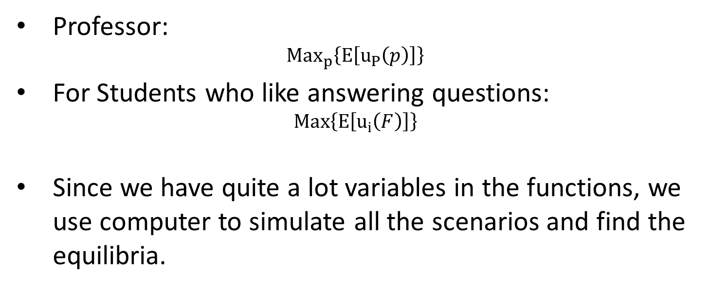
7
Maximize Expected Utilities
Professor:
$${Max}_{p}\left\{E\left[u_{P}\left(p\right)\right]\right\}$$
For Students who like answering questions:
$$Max\left\{E\left[u_{i}\left(F\right)\right]\right\}$$
Since we have quite a lot variables in the functions, we use computer to simulate all the scenarios and find the equilibria.

Slide 14
8
Simulation
We simulate asking questions for 10,000 times then compute the means as the utilities of everyone
We then find the NE
We simulate all the possible
distributions of seats

Slide 15
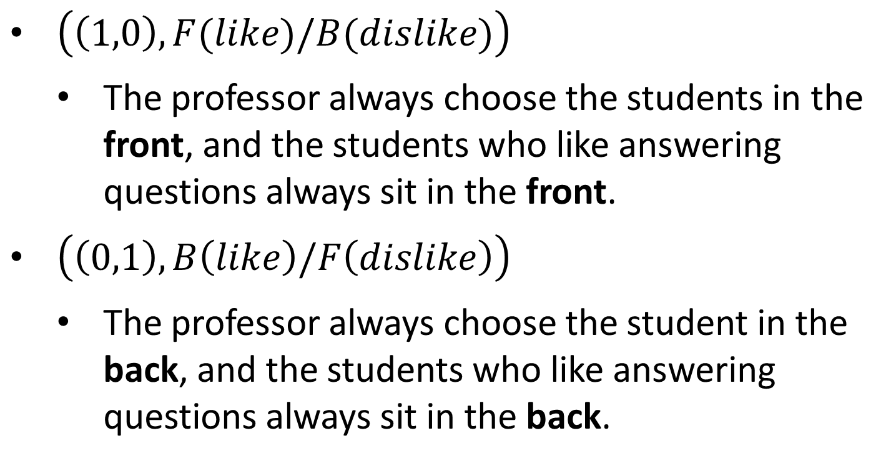
9
Nash Equilibria
$\left(\left(1,0\right),F(like)/B(dislike)\right)$
The professor always choose the students in the front, and the students who like answering questions always sit in the front.
$\left(\left(0,1\right),B\left(like\right)/F\left(dislike\right)\right)$
The professor always choose the student in the back, and the students who like answering questions always sit in the back.

Slide 16
9
Modifications
Seats are not enough, then we need to consider personal preference.
Additional utility can be very high or very low, thus the utility students get from answering questions can be ignored or exaggerated.

Slide 17
10
Interesting Things
Sitting in the back
is so nice
NO NO NO!
Don't choose me !

Slide 18

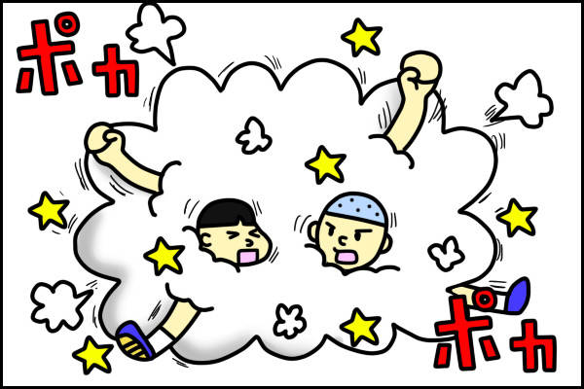



11
Why We Changed Our Topic

Slide 19
11
Why We Changed Our Topic
The price of taxis hardly ever changed since the appearance of Didi.
Taxis are not owned by a commercial company, but closely related to the government; and when the government is making a decision, it’s not only about the profit, but the society’s social welfare.

Slide 20
THANK
YOU

